Slide 1

Introduction to Geographic Information Systems
Peter Galante
Biodiversity Informatics Scientist
Center for Biodiversity and Conservation
American Museum of Natural History

Slide 2
Outline
How do we represent real world geographic information with a computer?
What is a Geographic Information System?
Data models – representations of geographic reality
GPS
Georeferencing, sampling bias
Remote Sensing

Slide 3


Notable GIS software
Commercial:
ArcGIS, including ArcMap (Esri)
IDRISI (Clark Labs)
ERDAS IMAGINE (ERDAS Inc.)
Open source:
Quantum GIS
GRASS GIS
MANIS tool
GPSvisualizer
Biogeomancer
Free (but not open source):
DIVA GIS

Slide 4
What is a Geographic Information System?
A Geographic Information System (GIS)
software, hardware, geographic information, spatially explicit data
Software can be used to store, query, manage, analyze and display spatial data.
A GIS links cartographic, statistical, and data-basing technologies.

Slide 5
What is a Geographic information system?
Data (layers)
Spatial – Images, shape data, geographic information
Tabular – Spreadsheet data with geographic properties

Slide 6
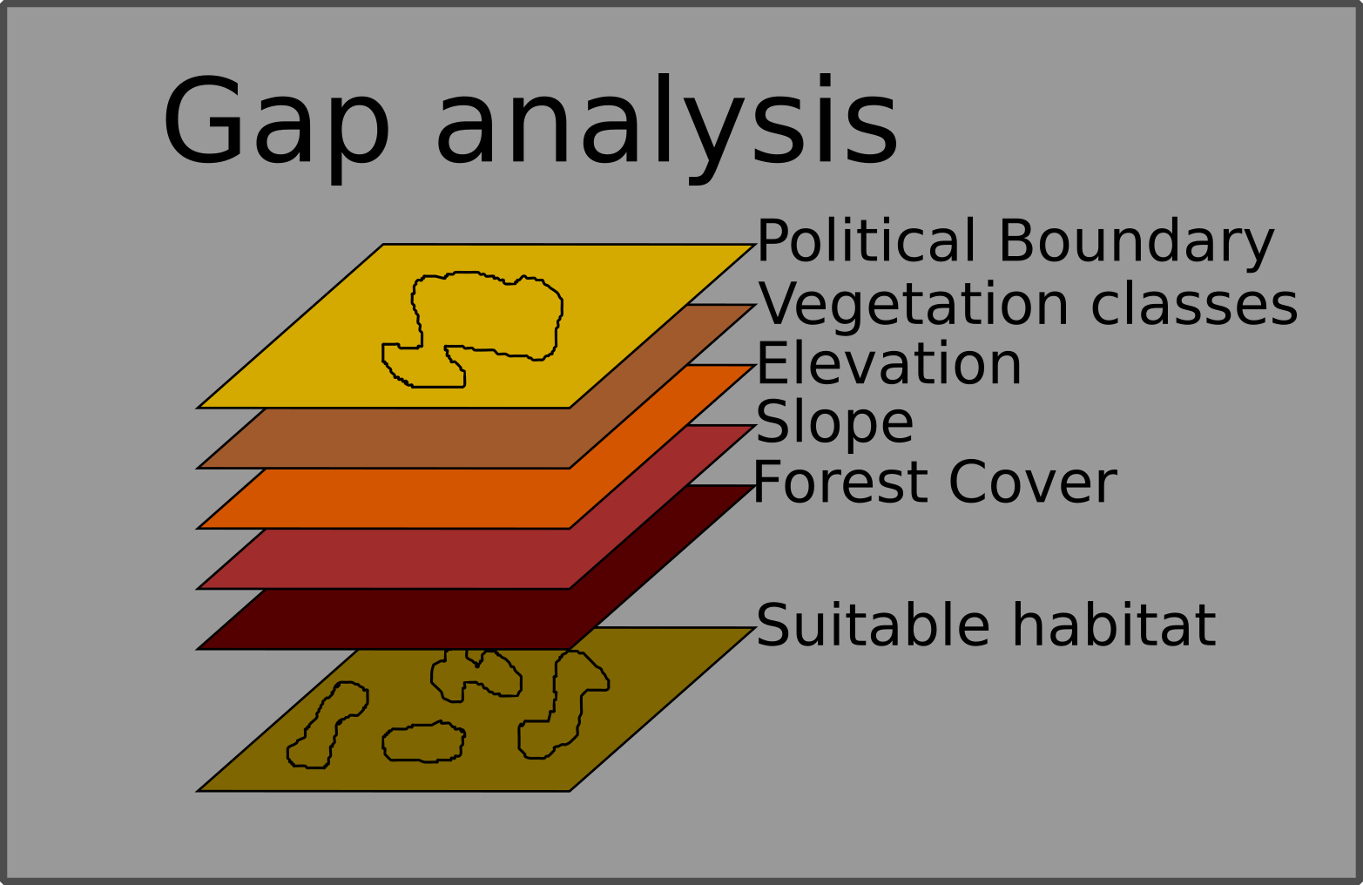
Layering

Slide 7
Outline
How do we represent real world geographic information with a computer?
What is a Geographic Information System?
Data models – representations of geographic reality
Georeferencing, sampling bias
Remote Sensing

Slide 8
Two methods of GIS representation
There are two main ways a GIS can create a logical data model of the world:
- Raster = continuous fields
- Vector = discrete features

Slide 9
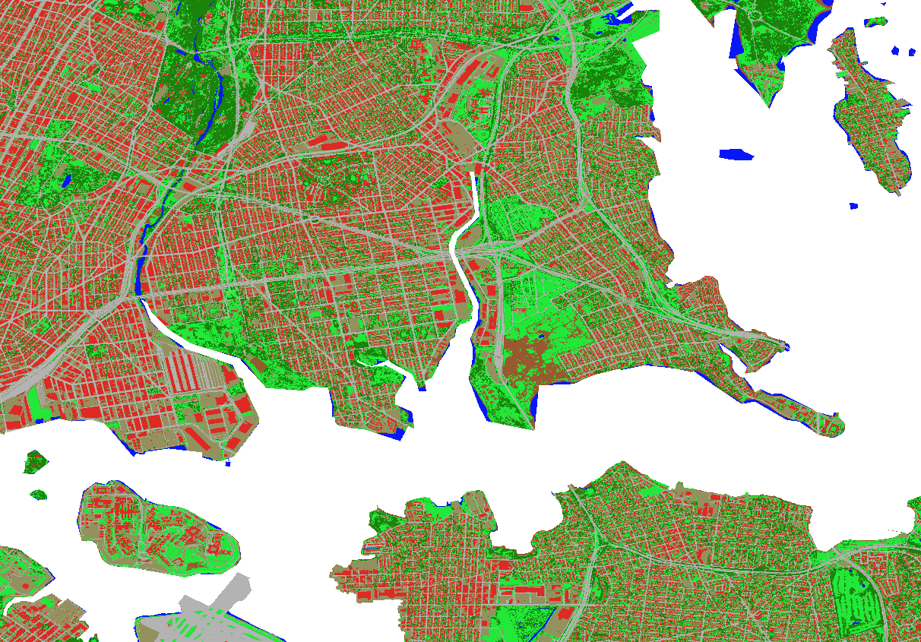
Two methods of GIS representation
There are two main ways a GIS can create a logical data model of the world:
- Raster = continuous fields
- Vector = discrete features

Slide 10
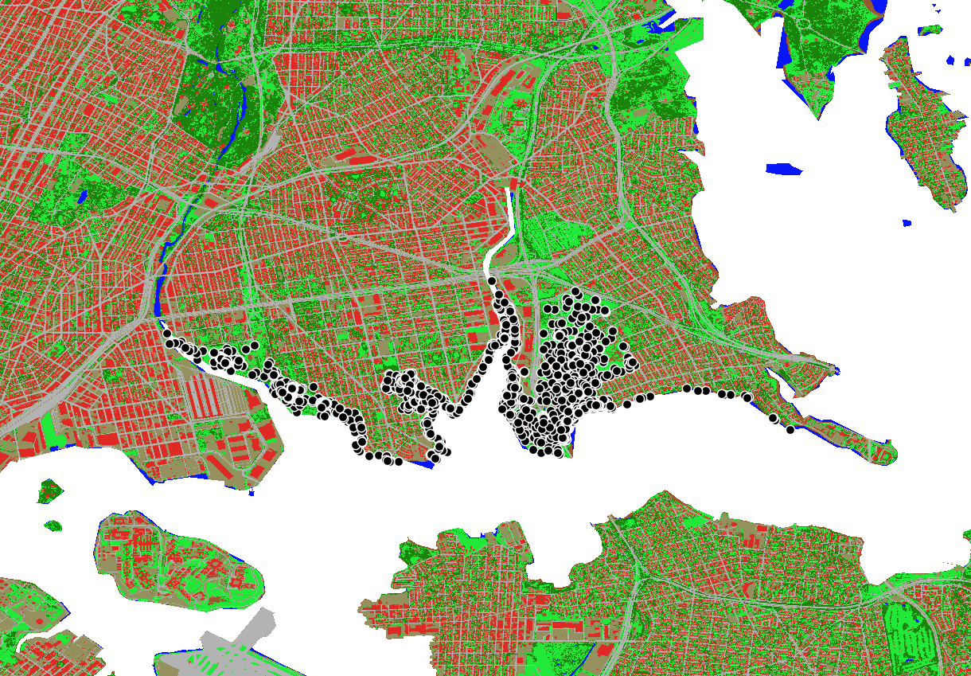
Two methods of GIS representation
There are two main ways a GIS can create a logical data model of the world:
- Raster = continuous fields
- Vector = discrete features

Slide 11
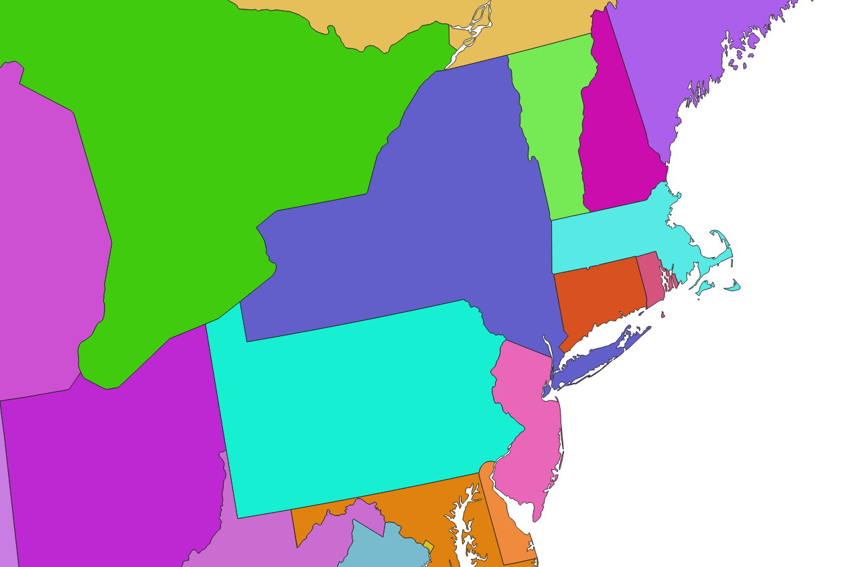
Vector
Discrete objects
Represents the geographic world as objects with well-defined boundaries in otherwise empty space

Slide 12
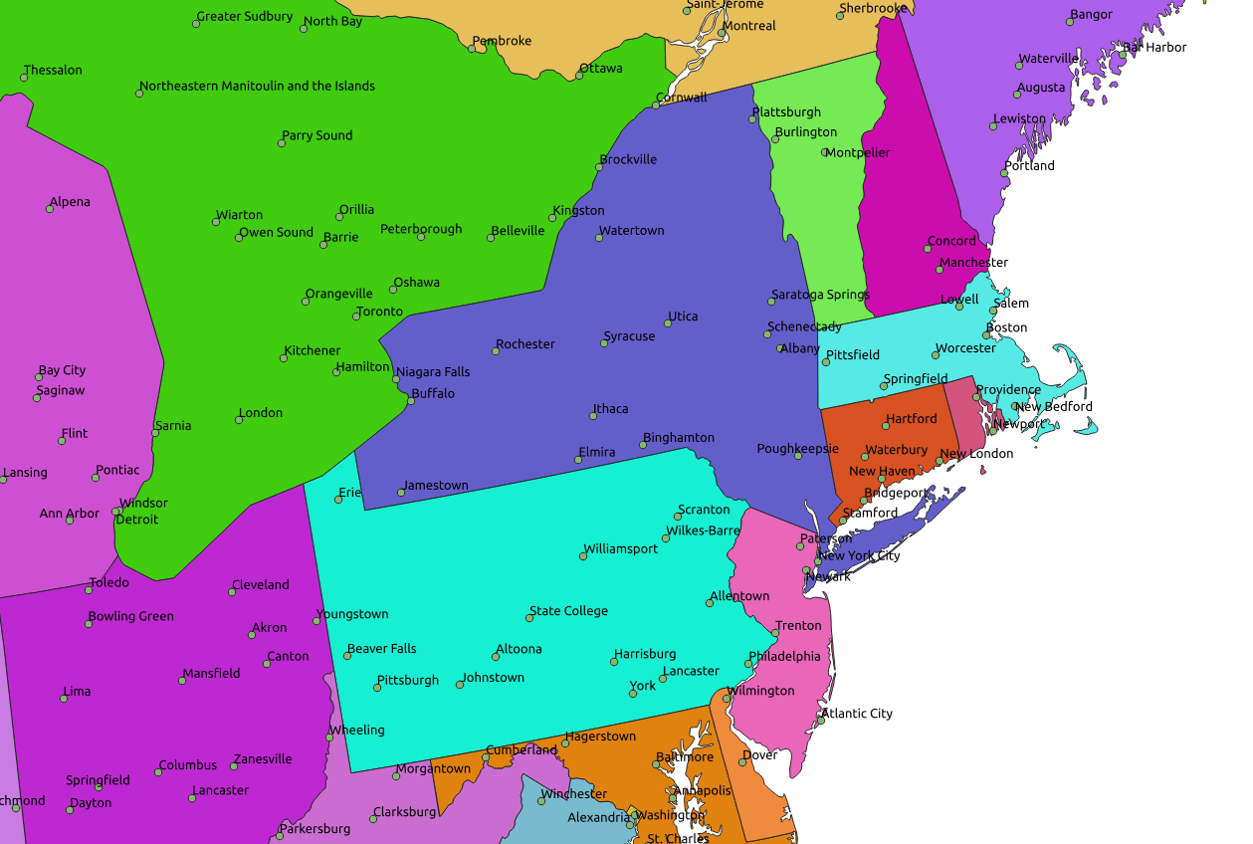
Vector
Discrete objects
Represents the geographic world as objects with well-defined boundaries in otherwise empty space

Slide 13
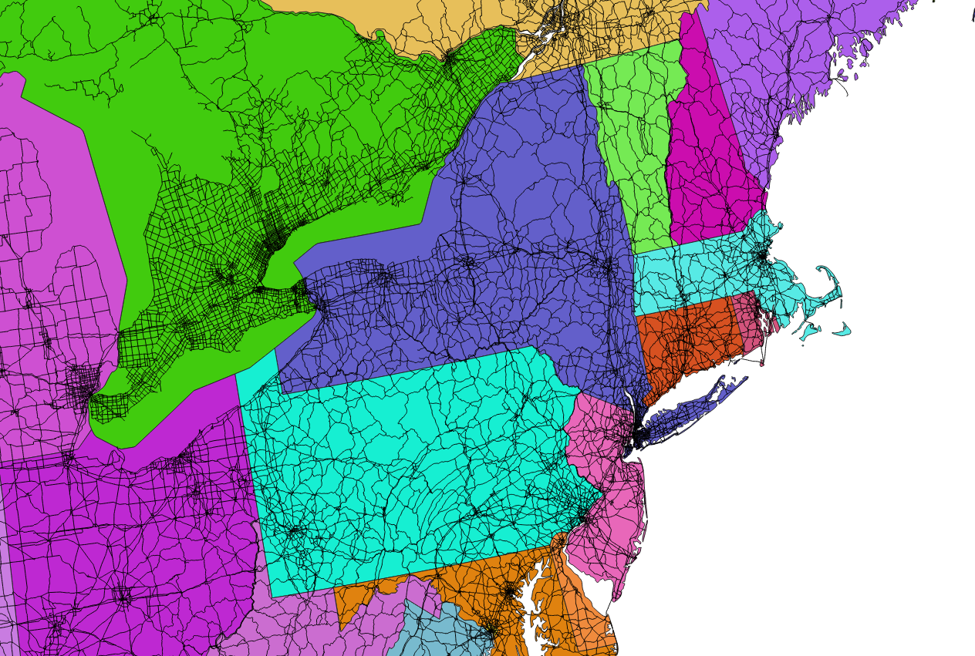
Vector
Discrete objects
Represents the geographic world as objects with well-defined boundaries in otherwise empty space

Slide 14
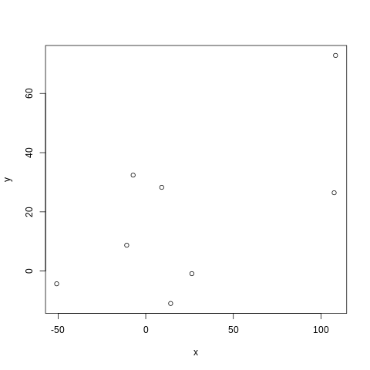
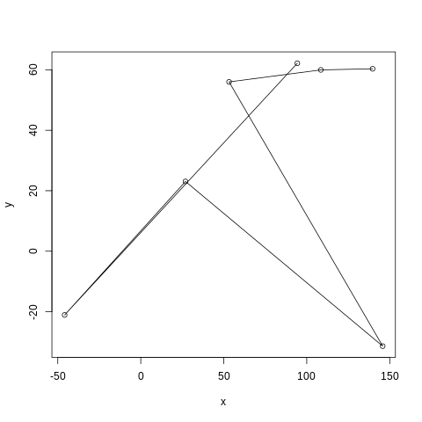
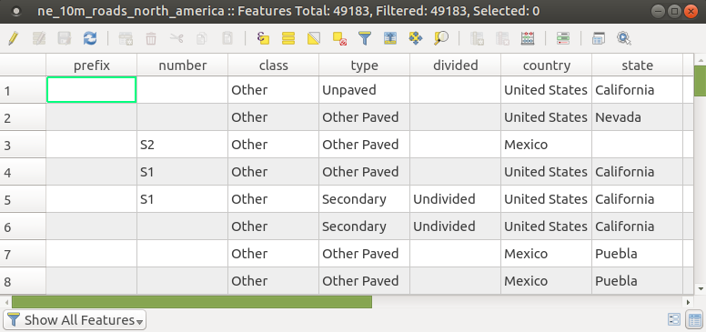
Vector Data
- Vector data represents features as points, lines, and polygons.
- It is best applied to discrete
objects with defined shapes
and boundaries.
- It is tied with tabular data
Examples include:
GPS points
Roads
Protected areas

Slide 15
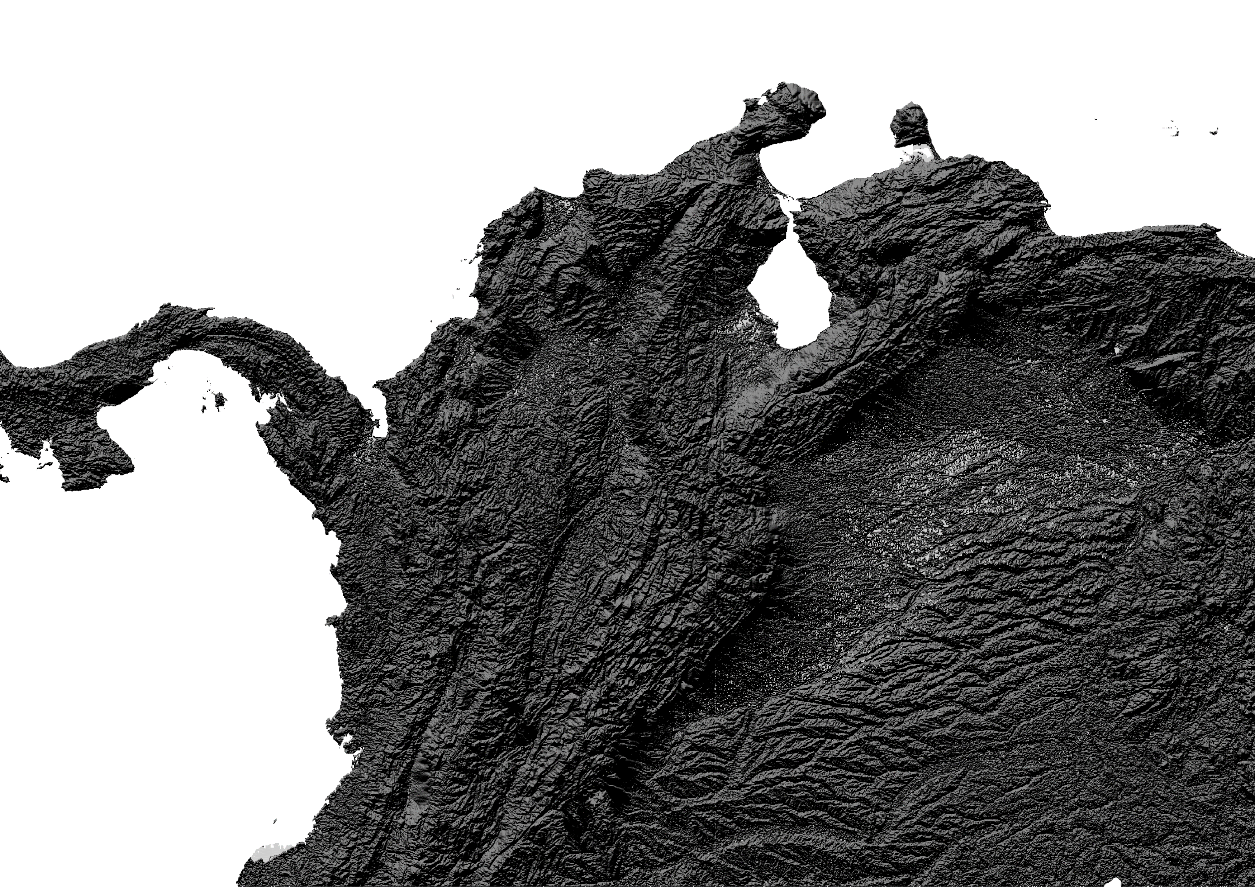
Raster
Continuous fields
Represents the real world as a finite number of variables, each one defined at every possible position.
E.g. a Digital Elevation Model

Slide 16
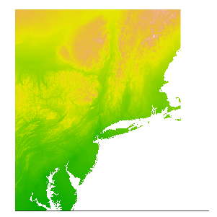
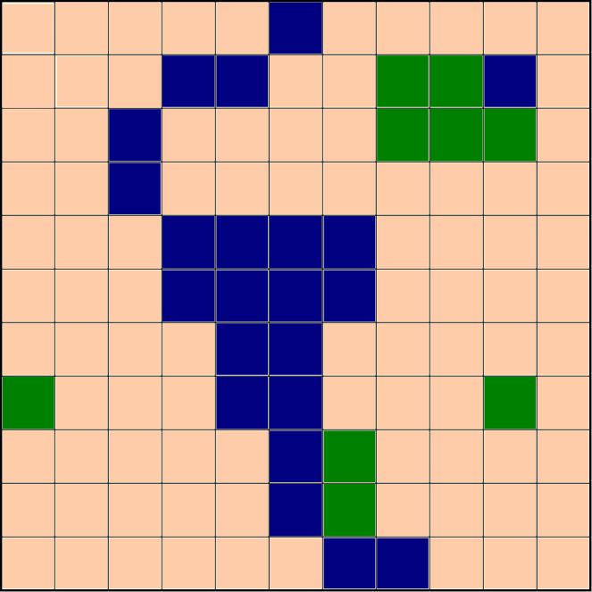
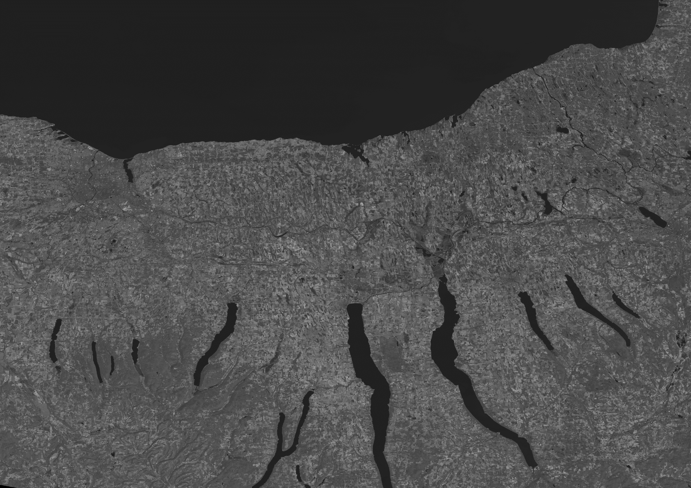
Raster Data
A raster model represents the world as a surface that is divided into a regular grid of cells, each of which are assigned a value.
Raster data includes images and grids.
aerial photograph, a satellite image,
or a scanned map, are often used
for generating raster datasets.

Slide 17
General data issues: spatial scale
Spatial scale has two elements: resolution and extent
Decrease in resolution
Increase in extent
Resolution and extent tend to be
inversely related
Extent
Resolution

Slide 18
Vector data
Advantage
precise representation of points, boundaries, and linear features
defining spatial relationship (connectivity and adjacency) between coverage features
network analysis (for example to find an optimal path between two nodes in a complex transport network)
Disadvantage
boundaries of the resulting map polygons are discrete/enclosed by well-defined boundary lines. In reality the map polygons may represent continuous gradation or gradual change, as in soil maps
Resolution is not clear – how many points were used to make up a line?

Slide 19
Raster data
Advantage
Represent indistinct boundaries
thematic information on soil types, soil moisture, vegetation, ground temperatures
Reconnaissance satellites and aerial surveys use raster-based scanners
scanned images can be directly incorporated into GIS
Potential disadvantage
The higher the grid resolution, the larger the data file is going to be
If converting from vector to raster can lose information:

Slide 20
Outline
How do we represent real world geographic information with a computer?
What is a Geographic Information System?
Data models – representations of geographic reality
GPS
Georeferencing, sampling bias
Remote Sensing

Slide 21
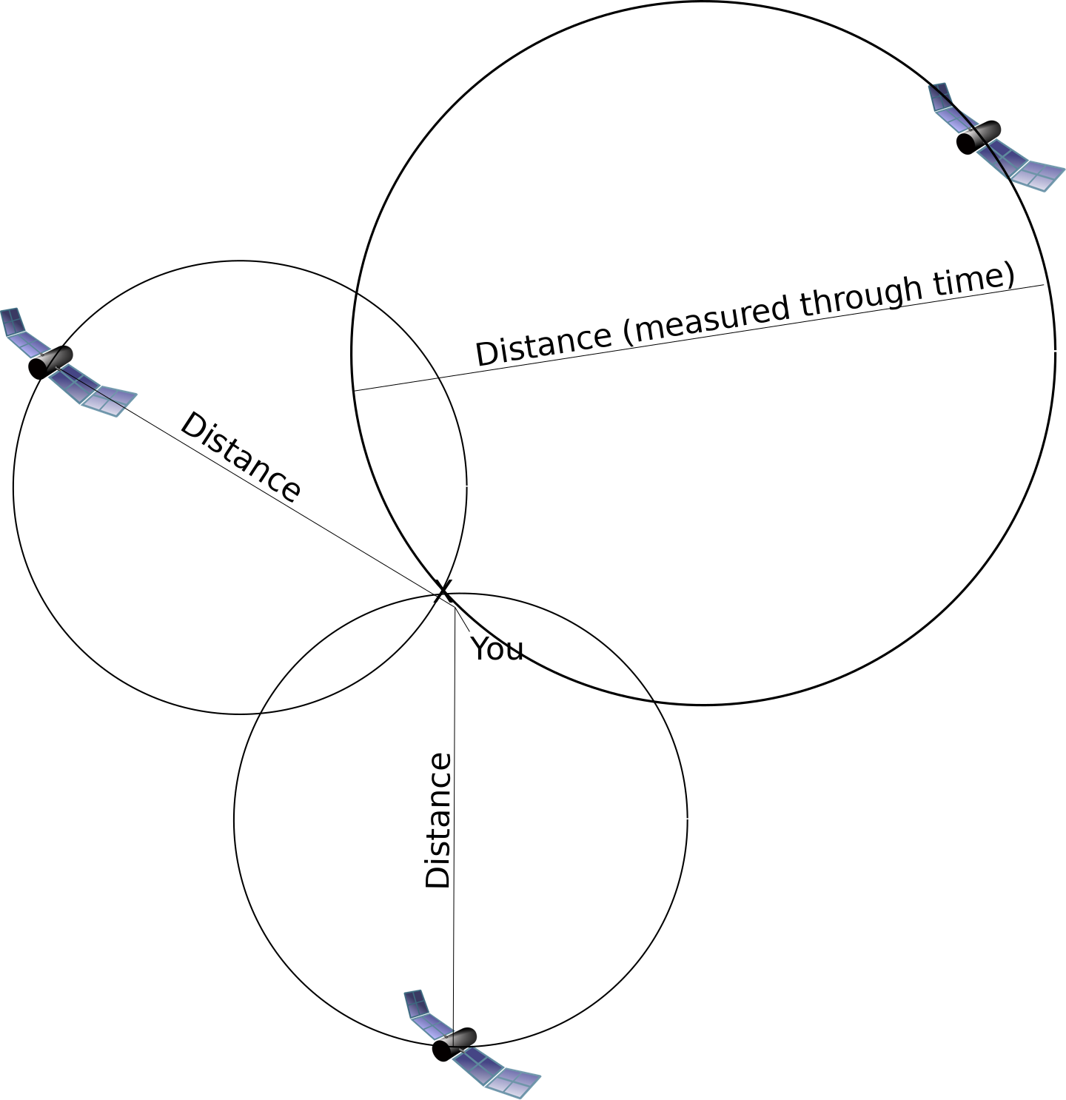
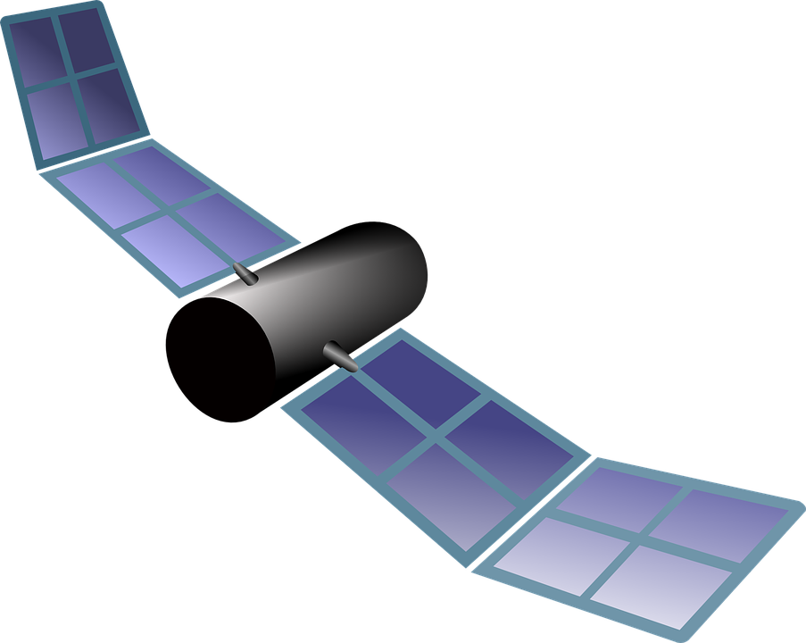
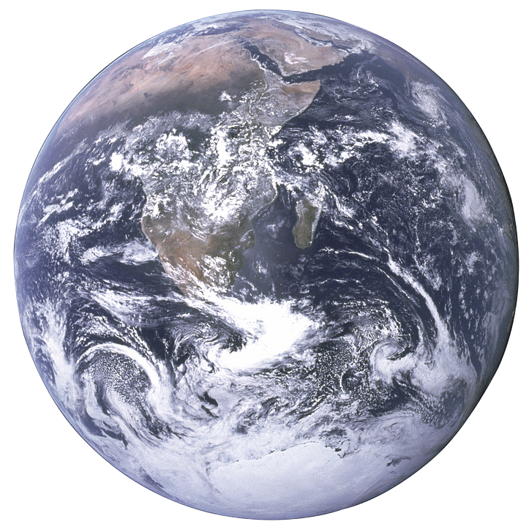
GPS

Slide 22
Outline
How do we represent real world geographic information with a computer?
What is a Geographic Information System?
Data models – representations of geographic reality
GPS
Georeferencing, sampling bias
Remote Sensing

Slide 23
Species’ distribution data: possible sources
Personal collection during field surveys (e.g., using a GPS receiver or smartphone)
Extracting data from large surveys (e.g., North American Breeding Bird Survey)
Digitizing atlases (e.g. The new atlas of breeding birds in Britain and Ireland: 1988-1991)
Collections in natural history museums
On-line distributed databases (e.g. GBIF, HerpNET, FishNET, ORNIS)

Slide 24
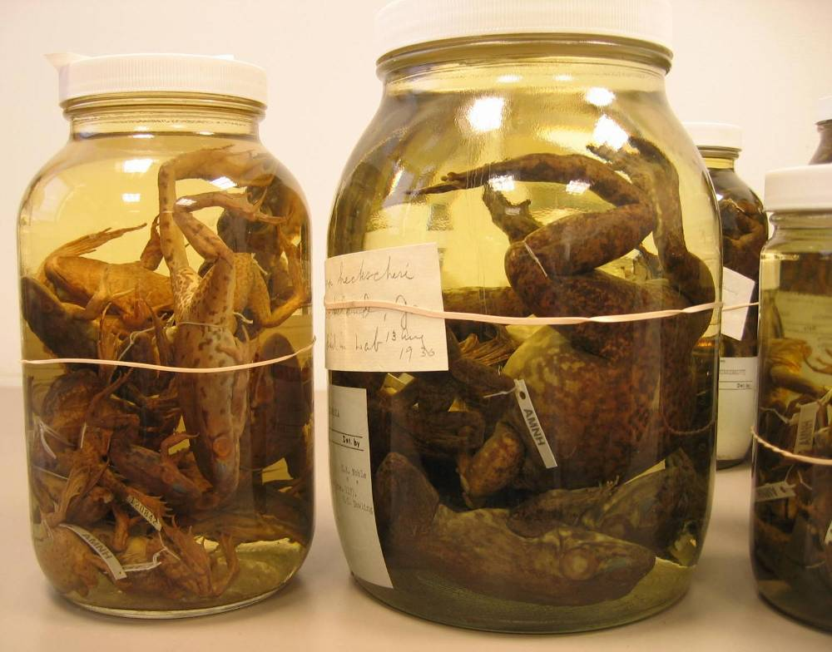
Georeferencing
Woodbury, NY
Near Woodbury
5 miles from Woodbury
1 mile east of Woodbury
10 minutes along the path leading out of Woodbury

Slide 25
Outline
How do we represent real world geographic information with a computer?
What is a Geographic Information System?
Data models – representations of geographic reality
GPS
Georeferencing, sampling bias
Remote Sensing

Slide 26
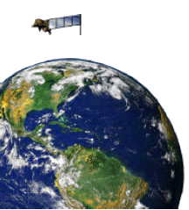
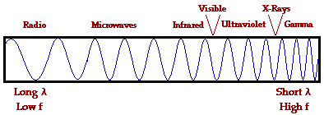
What is remote sensing?
General definition: Acquiring information about an object without physical contact.
Definition in context of Earth observation: A technology for sampling reflected and emitted electromagnetic (EM) radiation of features on the Earth's land surface, oceans, and atmosphere.
Source: P. Ersts, July 2004

Slide 27
GIS projects
The majority of your grade for this course will be based on a comprehensive final project. Ideally, your project will represent some aspect of your graduate research. It should be of sufficient quality to be used in a publication, whether as just a map (or series of maps), supporting documentation, or values generated as part of an analysis.
If you do not have a project, or an interesting spatial aspect of a project, we can chat and come up with one.

